Slide 1

Fabrication of bilayered electrolyte Er_{0.5}Bi_{1.5}O₃/Gd_{0.1}Ce_{0.9}O_{1.95} for low temperatures solid oxide fuel cells
Soukaina Mountadir, Victor Duffort, Rose-Noëlle Vannier
JNOEJC 2021 – 10th of June
UCCS Laboratory – Team: MISSP
University of Lille – Villeneuve-d’Ascq

Slide 2
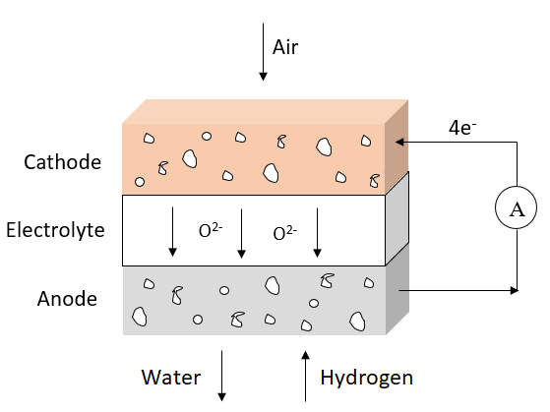
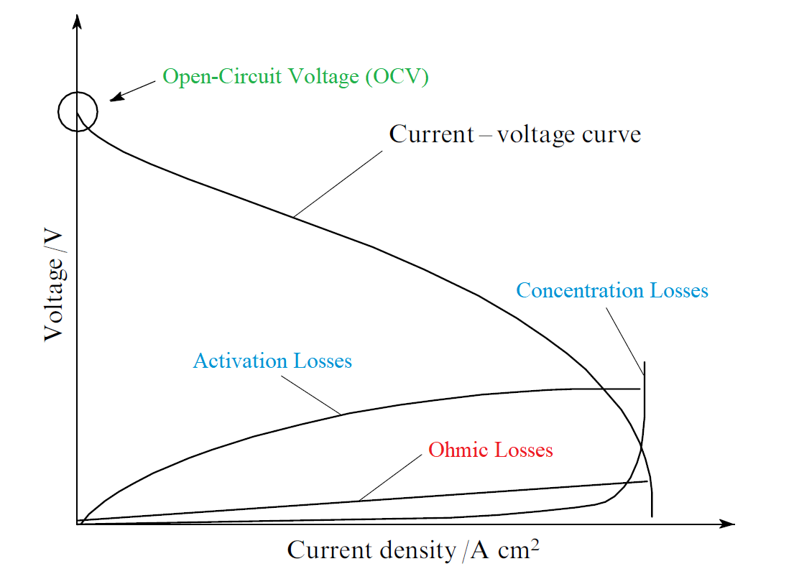


Operating principle of an SOFC
Reduction
Converts the chemical energy
into electrical energy
O₂ (g) + 4e⁻ 2O²⁻
∆E_{theoretical} $\left(T\right)=\text{∆}\text{E}°\text{th}eoretical\left(T\right)+\frac{R.T}{4Ϝ}.ln\left(\frac{P_{H_{2}O}^{2}}{P_{O_{2}}.P_{H_{2}}^{2}}\right)$
∆E_{theoretical} $\left(1000°C\right) \sim 1 V$
∆E_{experimental} = ∆E_{theoretical}− RI−|η_{anode}| − |η_{cathode}|
$$\sim 1 V$$
Oxydation
2H₂ (g) + 2O²⁻ 2H₂O(g)
Overall reaction :
2H₂(g) +O₂(g) 2H₂O + heat + electricity
Istomin et al. Russian Chemical Reviews 82(7) (2013) 686

Slide 3
Decreasing the operating temperature
Air
4e⁻
Cathode
Electrolyte
YSZ
A
O²⁻
Anode
Water
Hydrogen
Good mechanical et chemical stability
Mediocre conductivity under 700°C
Mechanical instability, chemical reactivity, electrode microstructure

Slide 4
Decreasing the operating temperature
Air
4e⁻
Cathode
Electrolyte
YSZ
A
O²⁻
Anode
Water
Hydrogen
In order to decrease the operating temperature, two approaches are possible :

Slide 5
Decreasing the operating temperature
Air
4e⁻
Cathode
Electrolyte
YSZ
A
O²⁻
Anode
Water
Hydrogen
In order to decrease the operating temperature, two approaches are possible :
Decrease the electrolyte thickness
Limited

Slide 6
Decreasing the operating temperature
Air
4e⁻
Cathode
Electrolyte
YSZ
A
O²⁻
Anode
Water
Hydrogen
In order to decrease the operating temperature, two approaches are possible :
Decrease the electrolyte thickness
Electrolyte with a better ionic conductivity
Limited

Slide 7
Electrolytes for Low Temperature SOFC (LT-SOFC)
Air
4e⁻
Cathode
Electrolyte
GDC
A
O²⁻
Anode
Water
Hydrogen
Cho et al., Electrochim. Acta, 56 (2011) 5472

Slide 8
Electrolytes for Low Temperature SOFC (LT-SOFC)
Air
4e⁻
Cathode
Electrolyte
e⁻
A
GDC
O²⁻
Anode
Water
Hydrogen
Electrolyte | Thickness | Maximum power density mW.cm⁻² at |  |  | OCV (V) 750°C
 |  | 650°C | 700°C | 750°C
GDC | 6 µm | 198 | 263 | 315 | 0,5
Reduction Ce⁴⁺ Ce³⁺
Electronic contribution
Cho et al., Electrochim. Acta, 56 (2011) 5472

Slide 9
Bilayered Electrolyte
Air
4e⁻
Cathode
YSZ
Electrolyte
A
GDC
e⁻
O²⁻
Anode
Water
Hydrogen
Electrolyte | Thickness | Maximum power density mW.cm⁻² at |  |  | OCV (V) 750°C
 |  | 650°C | 700°C | 750°C
GDC | 6 µm | 198 | 263 | 315 | 0,5
YSZ/GDC | 330 nm / 6 µm | 188 | 430 | 587 | 0,67
YSZ/GDC | 1 µm / 6 µm | - | 301 | 438 | 1,05
YSZ blocks the
electronic contribution
Cho et al., Electrochim. Acta, 56 (2011) 5472

Slide 10
Bilayered Electrolyte
Air
4e⁻
Cathode
ESB
~ 5 µm
A
Electrolyte
GDC
~ 10 µm
O²⁻
Anode
Water
Hydrogen
Maximum power density : 1.95 W.cm⁻² at 650 °C with Bi₂Ru₂O₇-ESB cathode
Operating temperature : 350°C with a Dy_{0,08}W_{0,04}Bi_{0,88}O_{1,56} (DWSB) electrolyte
Ahn et al. Electrochem. Comm., 11 (2009) 1504
Wachsman, American Ceramic Society Bulletin, 39 (2014) 773

Slide 11

OBJECTIVES
Air
ANR-BiBeLots
Cathode
Densification of the ESB
ESB
Electrolyte
4e⁻
GDC
O²⁻
Ni / GDC commercial half-cells with GDC
Anode
Water
Hydrogen
New cathode materials for low temperature SOFC

Slide 12
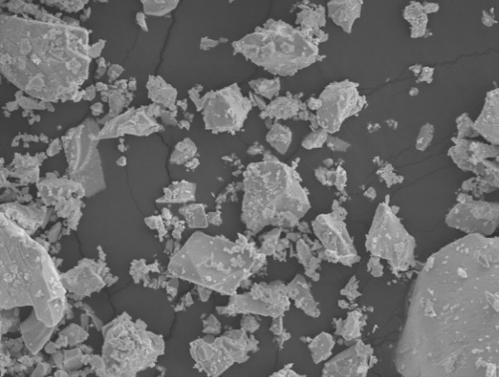
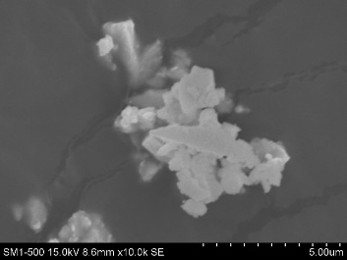
a)
Synthesis – Erbium Stabilized Bismuth
b
)
SYNTHESIS : Bi_{1.5}Er_{0.5}O₃ (ESB)
Coprecipitation
Citrate
10 µm
10 µm
c)
1 µm
1 µm
1 µm

Slide 13
a)
Powder choice – Erbium Stabilized Bismuth
b
)
SYNTHESIS : Bi_{1.5}Er_{0.5}O₃ (ESB)
Coprecipitation
Citrate
Formation of grain boundaries
Grain expansion
10 µm
10 µm
Elimination of porosity
c)
More reactive sintering
1 µm
1 µm
1 µm

Slide 14
a)
Powder choice – Erbium Stabilized Bismuth
b
)
SYNTHESIS : Bi_{1.5}Er_{0.5}O₃ (ESB)
Citrate
ESB prepared with citrate method
Smaller grain size
Denser layer
Thinner layer
Formation of grain boundaries
Grain expansion
10 µm
Elimination of porosity
c)
More reactive sintering
1 µm

Slide 15
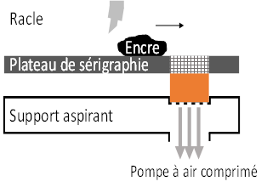
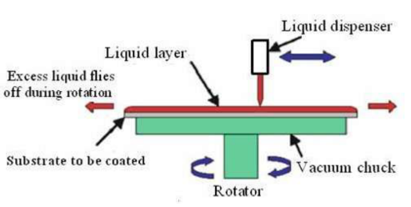
Ink preparation – Erbium Stabilized Bismuth
Powder choice
ESB (citrate) + dispersant + plasticizer
Screen printing
Spin Coating
Binder
High viscosity
Terpineol binder (EC3)
280°C
Low viscosity
450°C
PolyVinyl Butyral binder (PVB)

Slide 16
Sintering – Erbium Stabilized Bismuth
Formation of grain boundaries
Grain expansion
Elimination of porosity

Slide 17
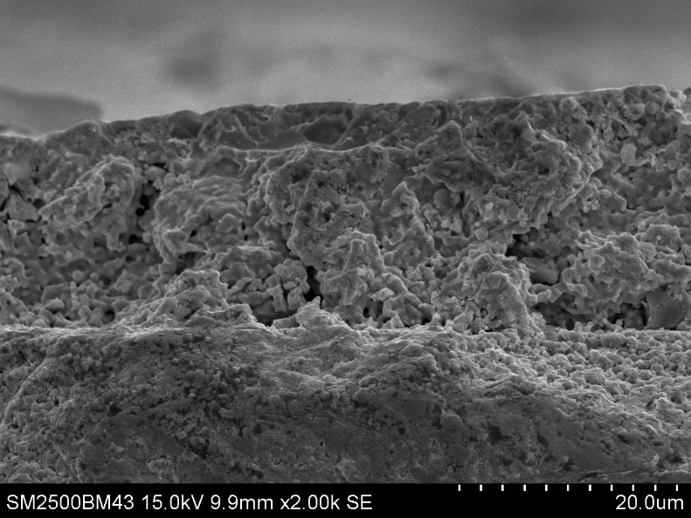
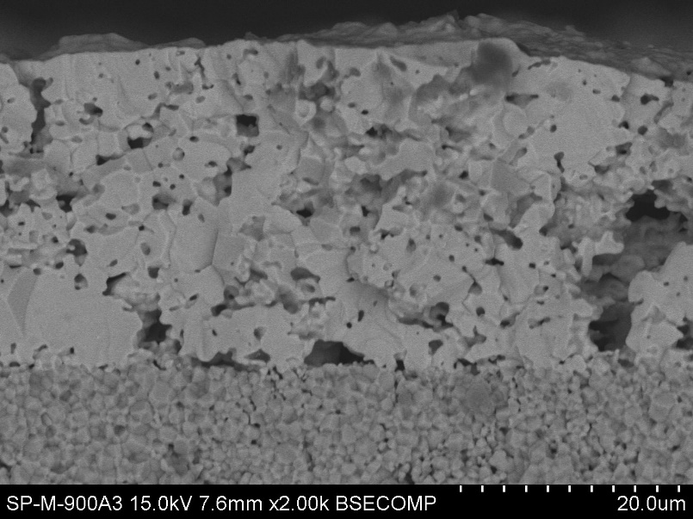
Sintering – Erbium Stabilized Bismuth
Formation of grain boundaries
Grain expansion
800°C -3h
20 µm
GDC pellet with 2 layers of ESB deposited by screen printing and sintered at 800 °C
Elimination of porosity
900°C -3h
20 µm
GDC pellet with 2 layers of ESB deposited by screen printing and sintered at 900 °C

Slide 18
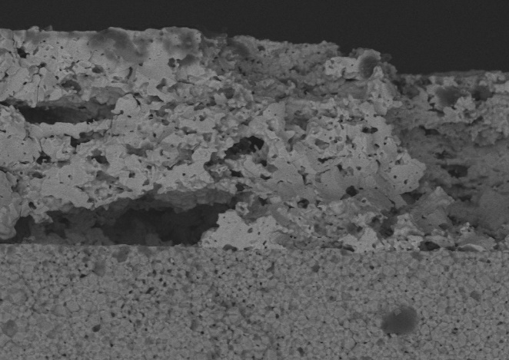
Deposition methods – Erbium Stabilized Bismuth
Ink with Terpineol binder (EC3)
Screen Printer
20 µm
GDC pellet with 2 layers of ESB sintered at 900 °C
Shaban et al. J. Modern Trends in Phys. R., 14 (2014) 91

Slide 19
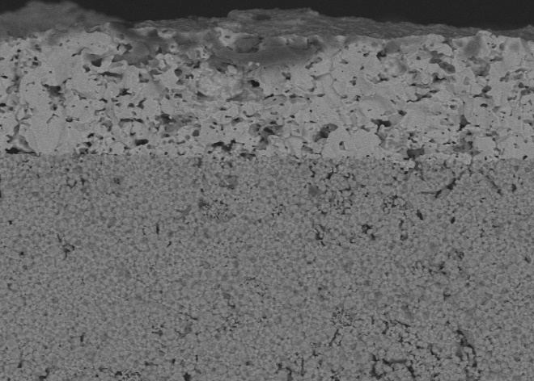

Deposition methods – Erbium Stabilized Bismuth
Ink with Terpineol binder (EC3)
Screen Printer
20 µm
Spin Coater
20 µm
GDC pellet with 2 layers of ESB sintered at 900 °C
GDC pellet with 2 layers of ESB sintered at 900 °C
Shaban et al. J. Modern Trends in Phys. R., 14 (2014) 91

Slide 20
Deposition methods – Erbium Stabilized Bismuth
Ink with Terpineol binder (EC3)
± 20 µm
± 40 µm
Screen Printer
20 µm
Spin Coater
20 µm
GDC pellet with 2 layers of ESB sintered at 900 °C
GDC pellet with 2 layers of ESB sintered at 900 °C
Interface problems
Good adhesion
Shaban et al. J. Modern Trends in Phys. R., 14 (2014) 91

Slide 21
Deposition methods – Erbium Stabilized Bismuth
Ink with Terpineol binder (EC3)
Ink with PolyVinyl Butyl (PVB)
± 20 µm
± 40 µm
± 4 µm
Screen Printer
20 µm
Spin Coater
20 µm
Spin Coater
20 µm
GDC pellet with 2 layers of ESB sintered at 900 °C
GDC pellet with 2 layers of ESB sintered at 900 °C
GDC pellet with 7 layers of ESB sintered at 900 °C
Interface problems
Good adhesion
Shaban et al. J. Modern Trends in Phys. R., 14 (2014) 91

Slide 22
Optimization of ESB deposition
900°C - 3h
?- 1h
? - 1h
280°C
450°C

Slide 23
Optimization of ESB deposition
900°C - 3h
450°C - 1h
280°C - 1h
± 5 µm
280°C
10 µm
450°C
± 5 µm
1 µm

Slide 24


CONCLUSION
ANR-BiBeLots
Air
4e⁻
ESB
Densification of the ESB
~ 5 µm
A
GDC
~ 10 µm
Water
Hydrogen

Slide 25

CONCLUSION
Coprecipitation
Citrate
ANR-BiBeLots
1 µm
1 µm
Air
4e⁻
ESB
Densification of the ESB
~ 5 µm
A
GDC
~ 10 µm
Water
Hydrogen

Slide 26
CONCLUSION
Coprecipitation
Citrate
ANR-BiBeLots
1 µm
1 µm
Air
4e⁻
Deposition method: Spin Coating
ESB
Densification of the ESB
~ 5 µm
A
GDC
~ 10 µm
Water
Hydrogen

Slide 27
CONCLUSION
Coprecipitation
Citrate
ANR-BiBeLots
1 µm
1 µm
Air
4e⁻
Deposition method: Spin Coating
ESB
Densification of the ESB
~ 5 µm
A
GDC
~ 10 µm
± 5 µm
Water
Hydrogen
1 µm
Two annealing steps at 280°C and 450°C

Slide 28
CONCLUSION
Coprecipitation
Citrate
ANR-BiBeLots
1 µm
1 µm
Air
4e⁻
Deposition method: Spin Coating
ESB
Densification of the ESB
~ 5 µm
A
GDC
~ 10 µm
± 5 µm
Water
Hydrogen
1 µm
Two annealing steps at 280°C and 450°C
ESB dense layer Cathode materials Complete cell

Slide 29
THANK YOU FOR
YOUR ATTENTION

