Slide 1



XXVII Congresso AIP – Sezione Sperimentale
8-10 settembre 2021
Multisensory integration of dynamic stimuli and the role of active touch.
Casado M.^{1,2},Campus C.¹,Tonelli A.1, Gori, M.¹
¹ Istituto Italiano di Tecnologia
² Università Degli Studi di Genova

Slide 2




Introduction
Active touch
Better recognition of objects (Morton, 1984),
More accurate perceived duration of tactile stimuli after adaptation (Tomassini et al., 2012)
How blind and sighted individuals process audio-tactile information, in passive and active conditions, during dynamic stimuli discrimination?

Slide 3
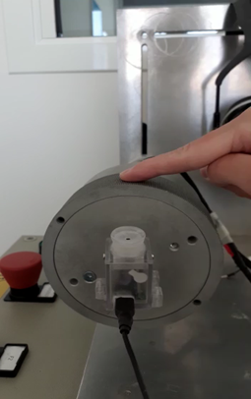
Experimental design
Experimental design
Study the velocity discrimination thresholds
Participants: 13 sighted individuals
Task: 2AFC
Standard speed: 3 cm/s (slow), 7 cm/s (fast)
Comparison speed: 2 Quest (Watson and Pelli, 1983)
v1
v2
T=1s
Pause
T=0.5s
T=1s

Slide 4
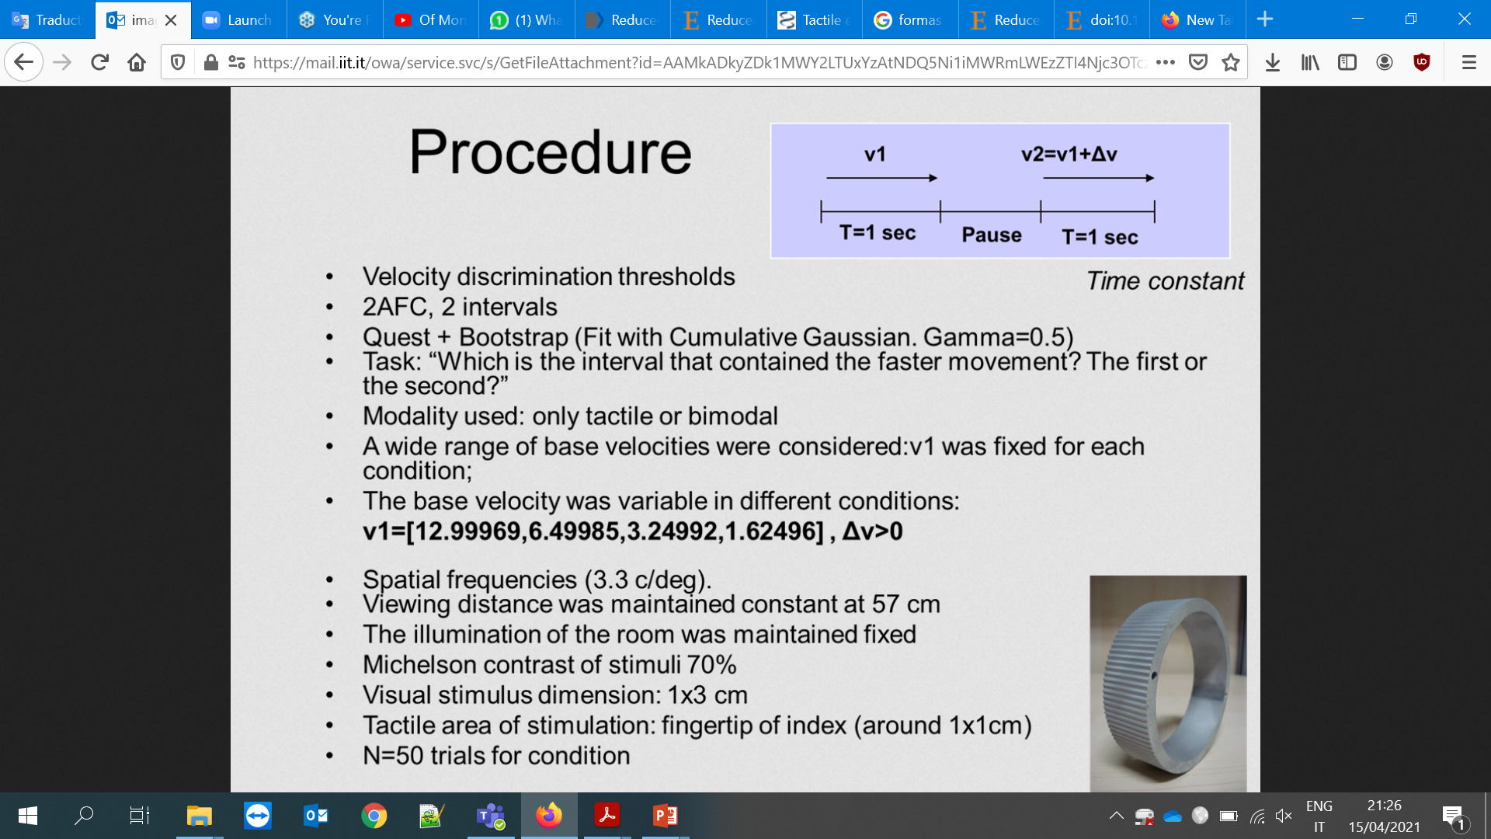
Experimental design
Trials: 30 per Quest/60 per condition: N= 180 trials total
Tactile stimulus: 10 cycles/cm
Audio stimulus frequency: bruco at 926 Hz (Monica et al., 2019)
Tactile area of stimulation: fingertip of index
Condition:
  Unimodal Tactile
  Unimodal Auditory
  Bimodal Audio-Tactile

Slide 5
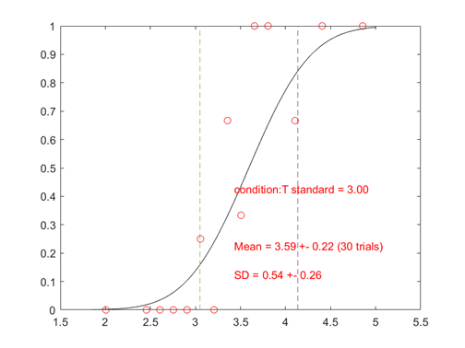
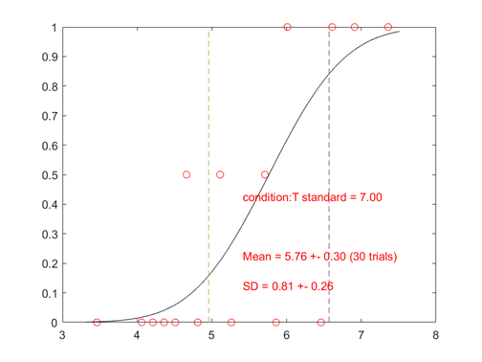
Analytical analysis
P(comparison faster)​
P(comparison faster)​
velocity cm/s
velocity cm/s
JND
PSE → BIAS

Slide 6
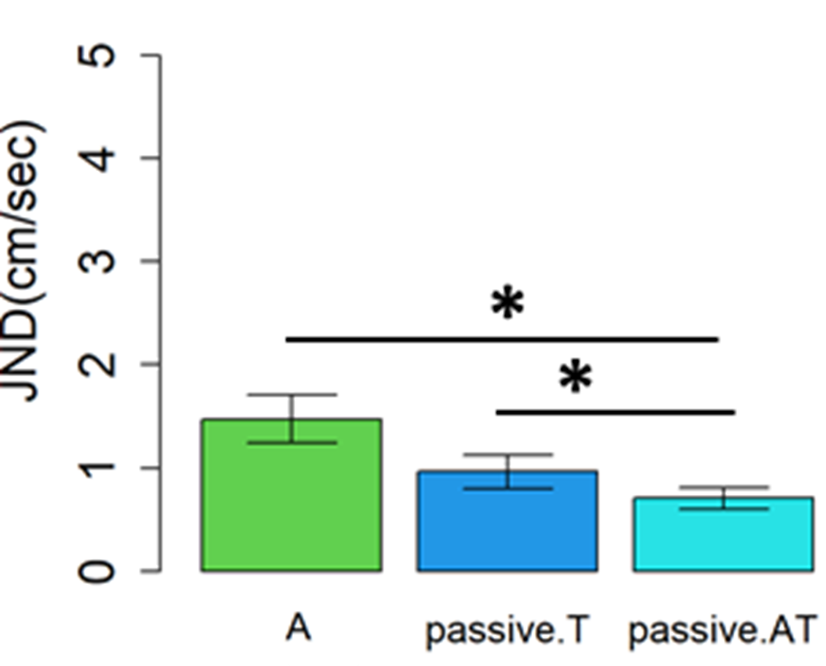
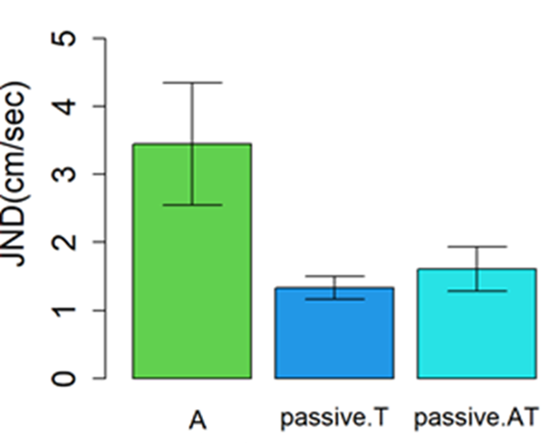
Results Exp1: Passive touch
Slow velocity (3cm/s)
N=13
Fast velocity (7cm/s)
Gain in the bimodal condition
No significant interactions

Slide 7

Results Exp1: Passive touch - Bayesian model
Slow velocity (3cm/s)
N=13
Where σT and σA are the tactile and auditory unimodal thresholds.
p-value =0.97

Slide 8
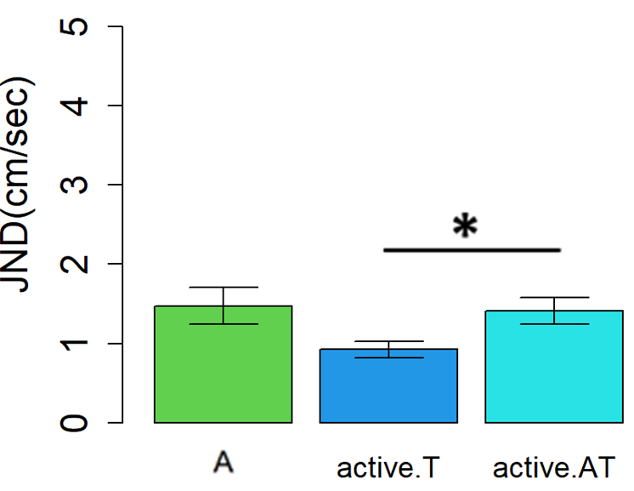
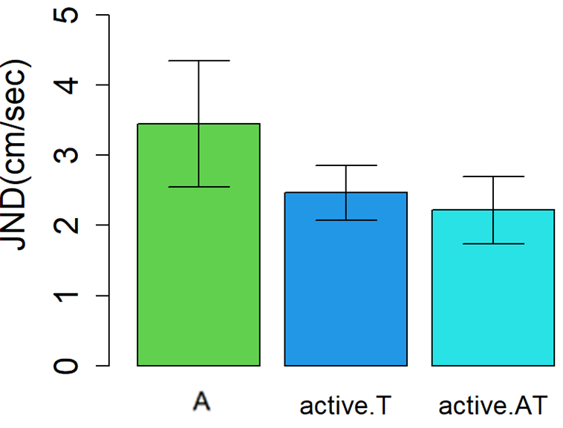
  Results Exp2: Active touch
Slow velocity (3cm/s)
N=13
Fast velocity (7cm/s)
No gain bimodal condition
No significant interactions

Slide 9


Conclusions
Passive touch:
Slow velocity
Multisensory integration
Fast velocity
Worse precision faster movements (e.g. Senna et al., 2015).
2. Active touch:
    No integration: different mechanism encoding multisensory integration.
Better performance during active touch (Morton, 1984).

Slide 10
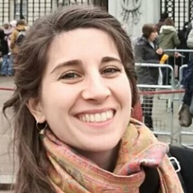

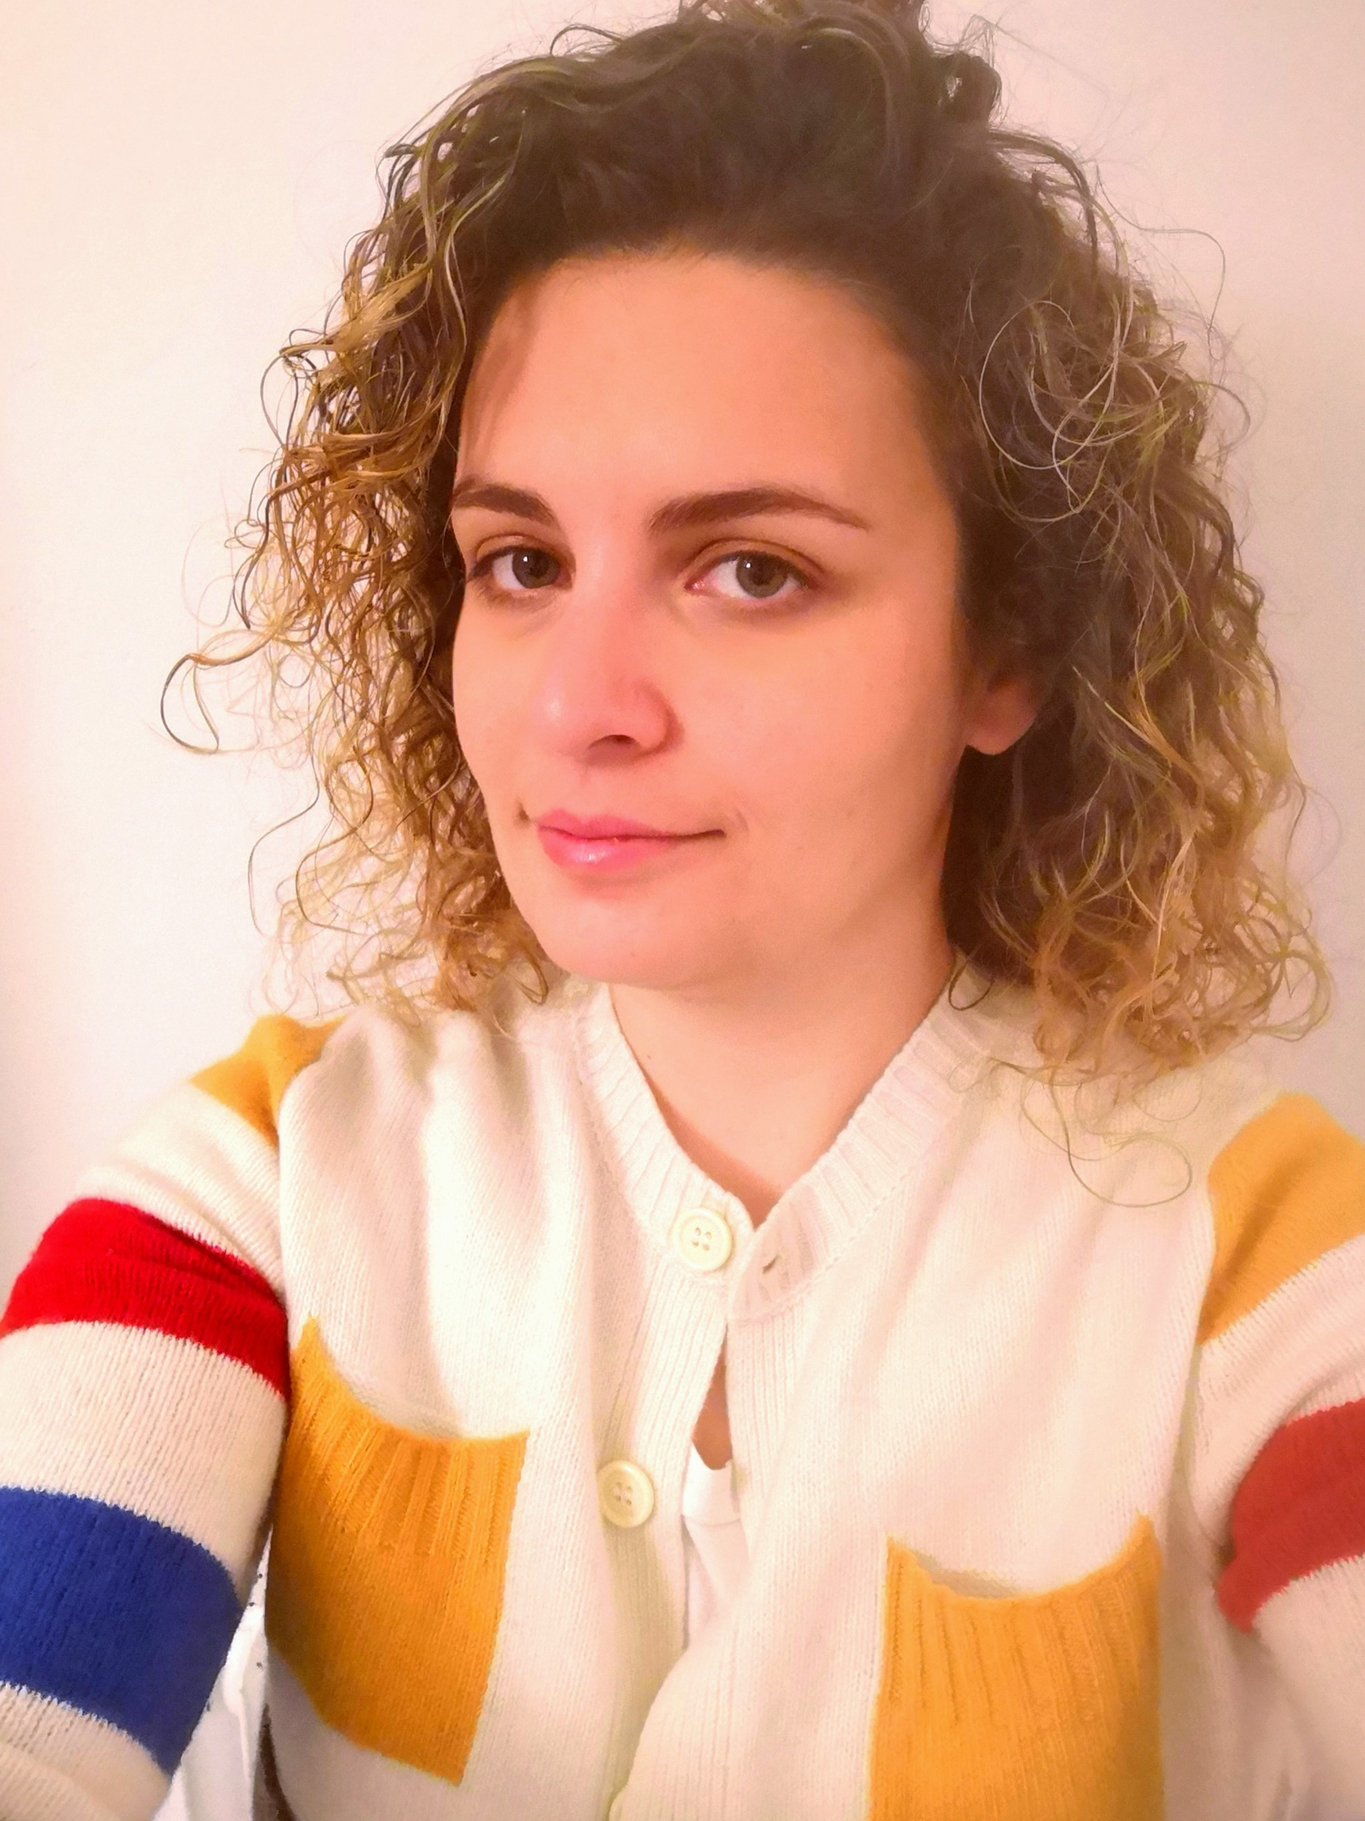
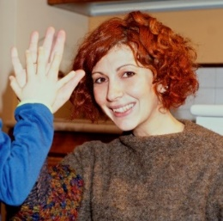
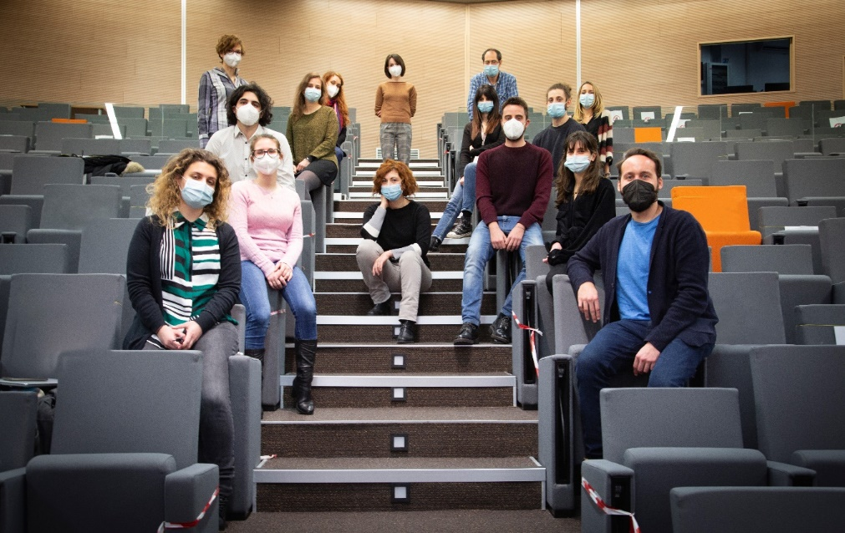


Thank you
Maria
Casado
Palacios
Claudio
Campus
Alessia Tonelli
Monica
Gori

