Slide 1
Cascade valorization of spent coffee grounds
Maxime Beaudor
Supervised : Vincent Phalip, Delphine Pradal, Peggy Vauchel and Abdulhadi Aljawish
Notes:
Hello, I would like to start by thanking the organization of this congress for allowing me to share my research work. My name is Maxime Beaudor and i am going to present you my thesis subject supervised by Vincent Phalip, Delphine Pradal and Peggy Vauchel from UMRT BioEcoAgro and the university of lille. I also want to thank the company gecco, the region haut de france and the I-site program for their financial support.

Slide 2
Coffee's place in the world
More than 9.9 million tons of coffee beans were produced between 2019 and 2020 in the world
2.4 million tons of coffee beans were consumed between 2019 and 2020 in Europe
[1]
3.2 billion cups of coffee were consumed everyday worldwide in 2018
[2]
4 ways to consume coffee : capsules, grinded, soluble, beans
[1]: International Coffee Organization
[2]: United States Department of Agriculture
Notes:
I would like to introduce the subject with some important figures, Almost 10 million tons of coffe beans are produced each year in the world and one quarter is consumed each year in europe. In total, more than 3 billion cups of coffee are drunk every day in the world. This figure can be explained by the variety of the consumption way which are appropriate for all the tastes, capsules, grinded, soluble or directly fresh roasted coffee beans in bars or restaurants. But before to being sold as a drink, there is a long manufacturing process that generates many co-products, including a major one that is the subject of my thesis, the spent coffee grounds. In fact for 1kilogram of green coffee beans, 650g of spent coffee grounds are generated and that represent approximately 140 coffee cup.

Slide 3
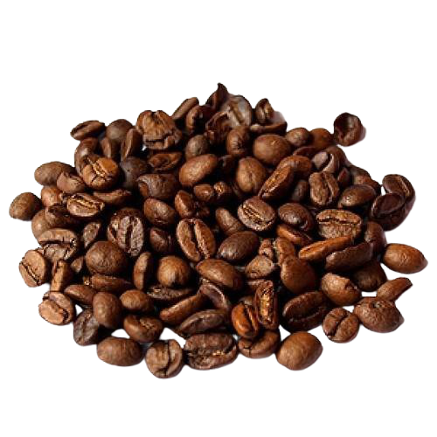
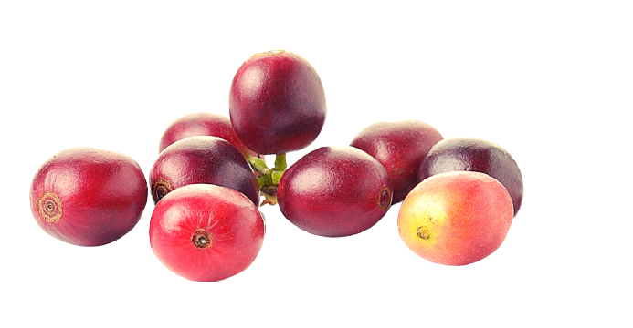
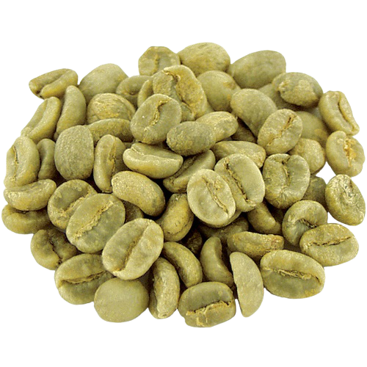
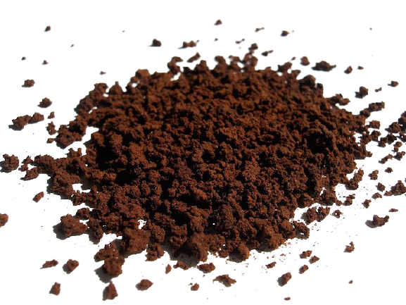
Coffee's place in the world
Coffee manufacturing process :
1 kg
140
Shelling
Roasting
Extraction
[1]
Fresh coffee beans
Green coffee beans
Roasted coffee beans
Coffee cup
650 g
Spent coffee ground
[1]: Ballesteros et al., 2014a; Mussatto et al., 2011a; Nabais et al., 2008
Notes:
But before to being sold as a drink, there is a long manufacturing process that generates many co-products, including a major one that is the subject of my thesis, the spent coffee grounds. In fact for 1kilogram of green coffee beans, 650g of spent coffee grounds are generated and that represent approximately 140 coffee cup.

Slide 4
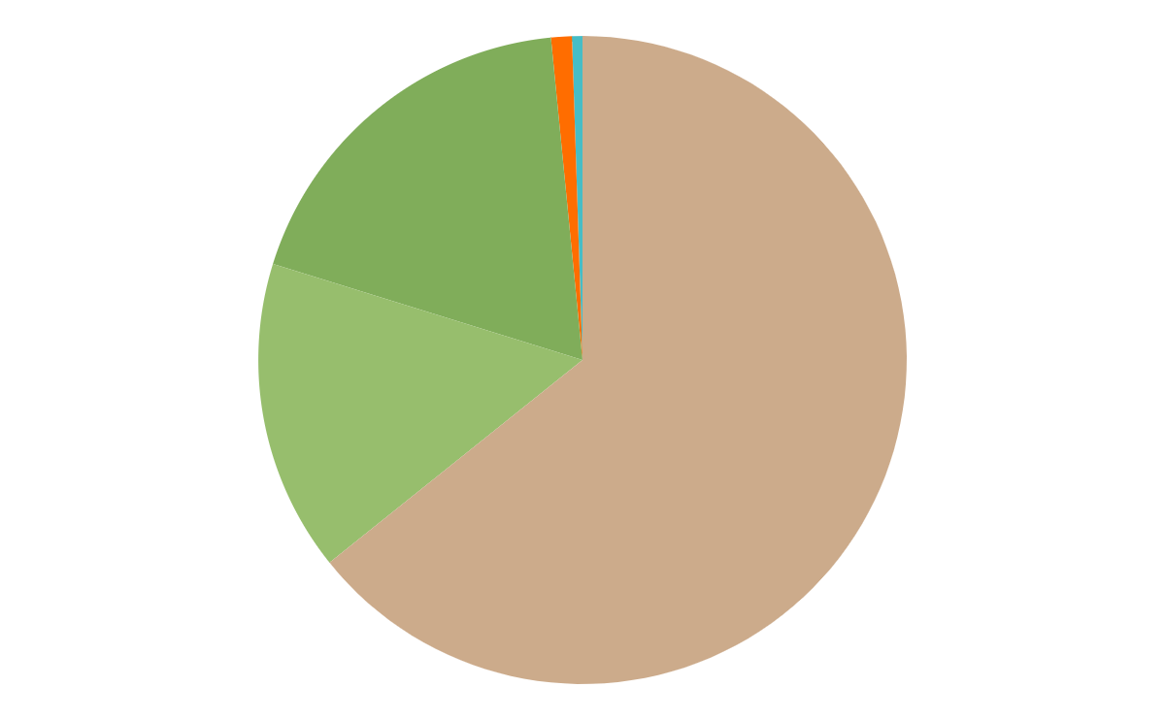
Spent coffee grounds and its applications
Spent coffee grounds composition
The main spent coffee grounds valorizations
Direct applications
Processed products
Extractions
Fertilizer
Compost
Biodiesel
Oil
14-17%
13-18%
60-65%
Incineration
Biogas
Added high-value molecules
[1]
[2]
[1]: Al-Hamamre et al., 2012; Kulkarni and Dalai, 2006; Petrik et al., 2014, Ballesteros et al., 2014; Jim.nez-Zamora et al., 2015
[2]: Galanakis C, 2017
Notes:
To better understand the possible uses of spent coffee grounds, it is important to know its composition. It is mostly composed of fibers, namely cellulose and hemicellulose, which are polymers of sugars, and lignin, which is a complex assembly of various molecules. But there is also a significant part of protein and lipids with some minerals and others molecules like melanoidines from the maillard reaction. Today, this biowaste is mainly incinerated as a common waste but it is also use in compost or directly as a fertilizer by mixing it with potting soil. It is mentioned in the literature as a source of high value added molecules and oil through extraction processes. To go a little further, incineration can be used to produce biogas and the oil can be used to produce fuel such as biodiesel with a transesterification reaction.

Slide 5
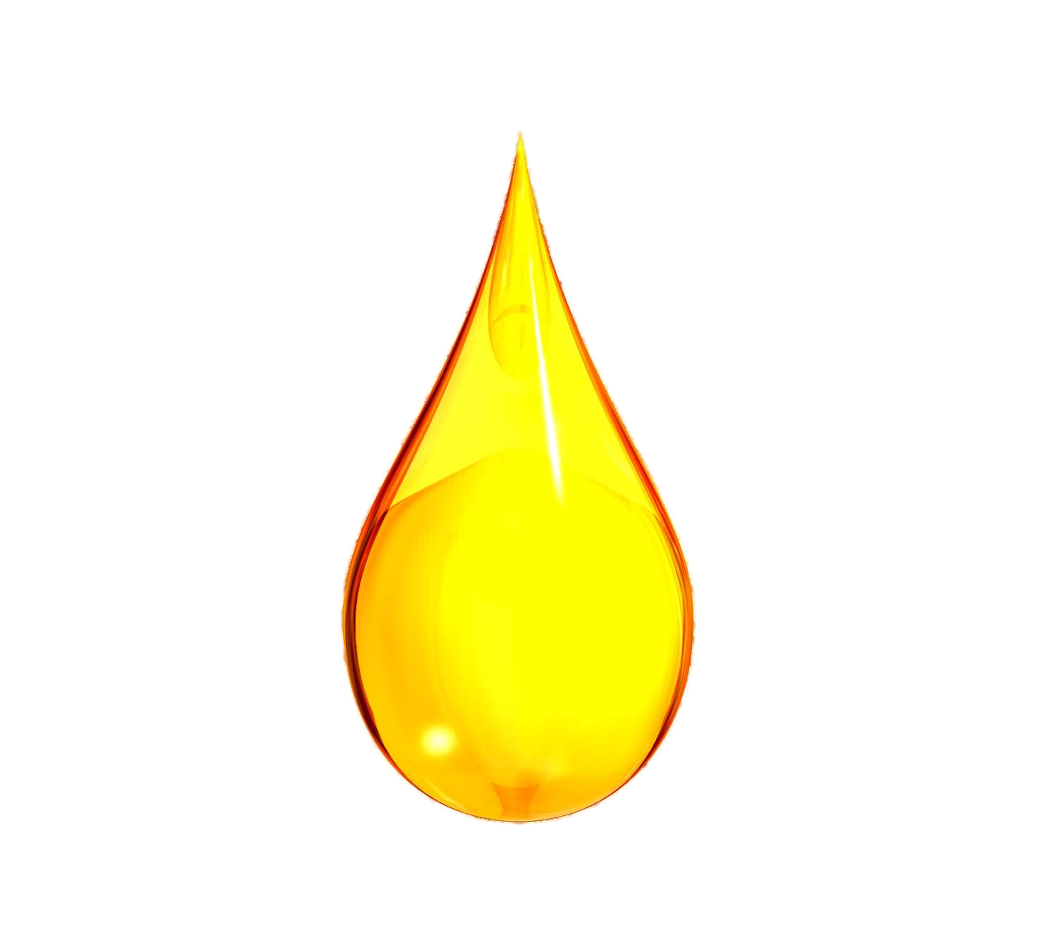
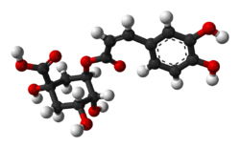
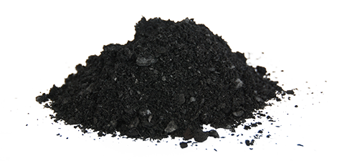
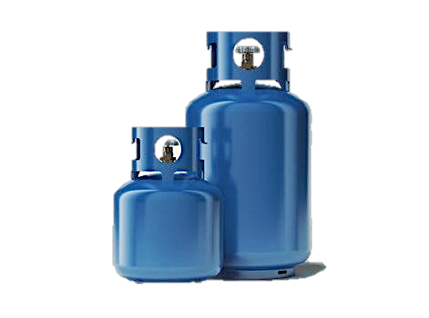
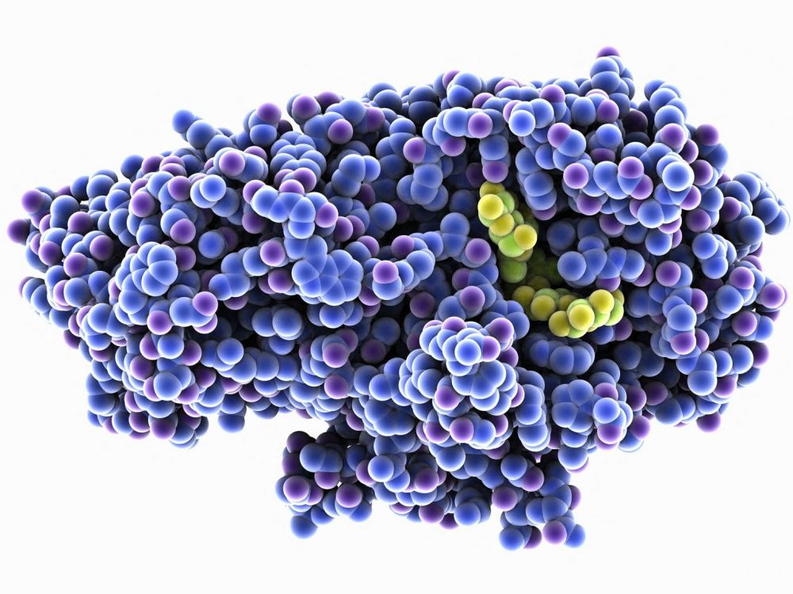
Cascade valorization applied to spent coffee de grounds
Roasted coffee beans
Coffee
Extraction
Thesis
Global project
Spent coffee grounds
Ressource exhaustion
Eco-extraction
Oil
Solid state fermentation
Pyrolisis
Biochar
Polyphenols
Enzymes
Biogas
Notes:
The objective of the thesis is to push this valorization further with cascade processes that allow to exhaust the resource to its maximum potential.
The thesis work that I will present to you is part of a larger project that aims to recover the remaining calories in the coffee grounds with a final step of pyrolisis, This last step is a research subject in Nantes. The first valorization is done around the eco extraction of polyphenols with ultraosunds. After a solid liquid phase separation, the solid phase is used as substrates for the production of enzymes with mushrooms isolated from coffee grounds.

Slide 6
Eco-extraction of antioxidant polyphenols
[1]
[2]
Eco-extraction
Polyphenols
Use of innovative processes
Main polyphenols in spent coffee grounds:
Chlorogenic acids:
5 CQA
3 CQA
3,5 diCQA
Ferulic acid
p-Coumaric acid
Gallic acid
Caffeic acid
Vanillic acid
Reduction of energy impact
Use of clean/green solvents
Reduction of process times
Antioxydant properties:
Application in cosmetic, food, pharmaceutical
[1]: Passos & Coimbra, 2013; Rocha and al., 2014; Michail and al., 2016; Pettinato and al., 2019
[2]: Scalbert et al., 2005; Samarin et al., 2012; Angeloni and al., 2020
Notes:
First of all, what is an eco-extraction, it is the use of innovative related processes that will allow a reduction of the environmental impact of the extraction.
This implies a decrease in electricity consumption compared to conventional processes and the use of green solvents such as ethanol for example. The benefits are numerous and these processes are often more efficient because they also save time.
As said before, the molecules we are trying to extract are polyphenols, the spent coffee grounds contain mainly chlorogenic acids and other acids like Caffeic acid, ferulic acid or vanilic acid. Polyphenols have antioxidant properties and are used in many industries such as cosmetics, food and pharmaceutical

Slide 7
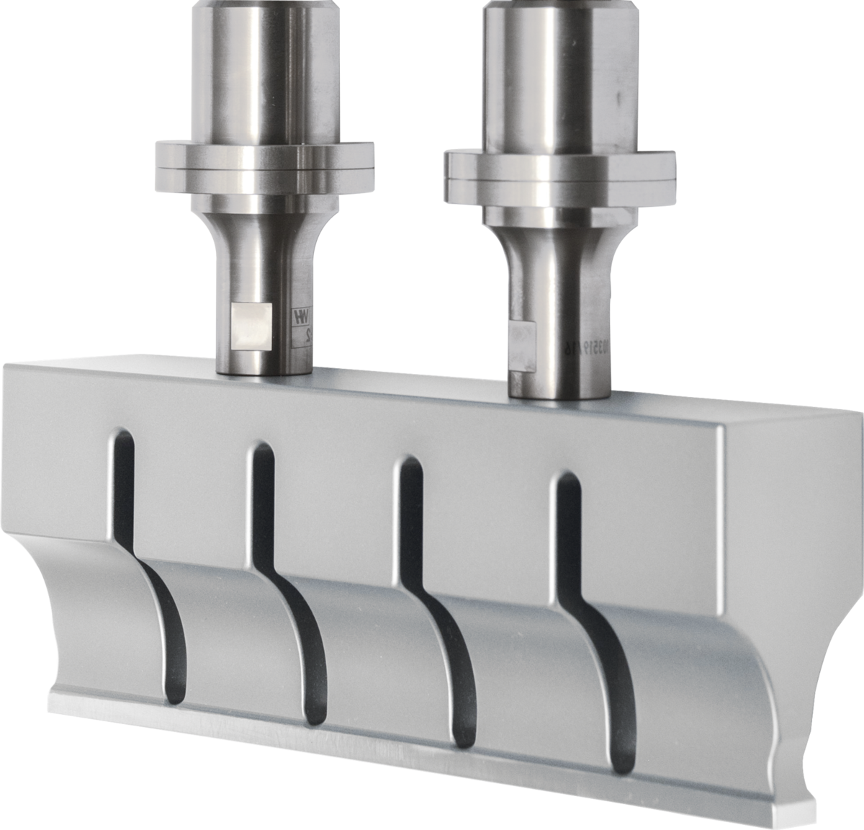
Eco-extraction of antioxidant polyphenols
Conventionnal
Ultrasounds
From 25 to 70°C
From 50 to 400 Watt
700 mL volume, From 0 to 50% ethanol in solvent, 150 rpm, solid to liquid ratio 1 g : 40 mL
Notes:
the use of ultrasound to extract molecules in solid-liquid extraction is part of this innovative process.
Indeed, sonotrodes placed in contact with the solvent containing the vegetal matrix will allow the appearance of small cavitation bubbles which will deform and eventually implode. This implosion will have several effects such as the rise of the solvent emperature due to the released heat, as well as a destructuring mechanical impact on the vegetal matrix

Slide 8
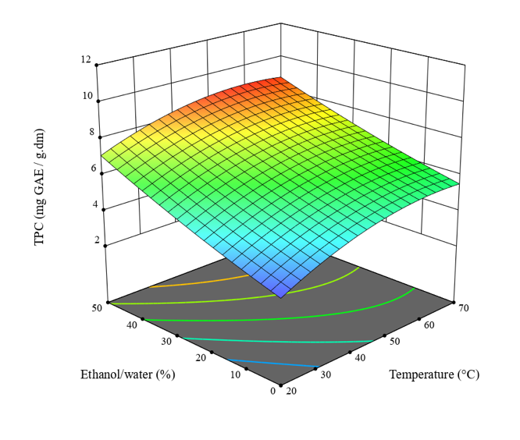
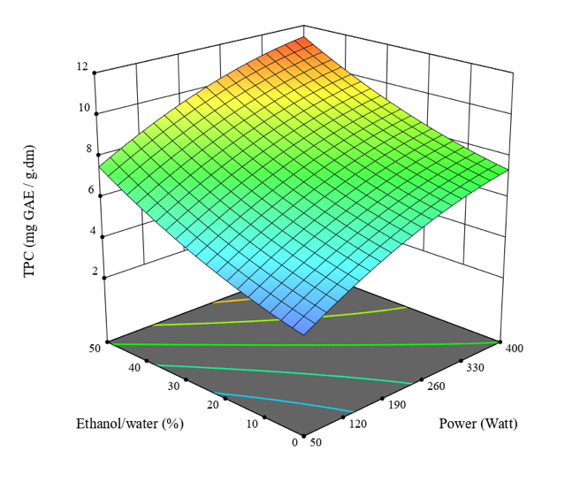
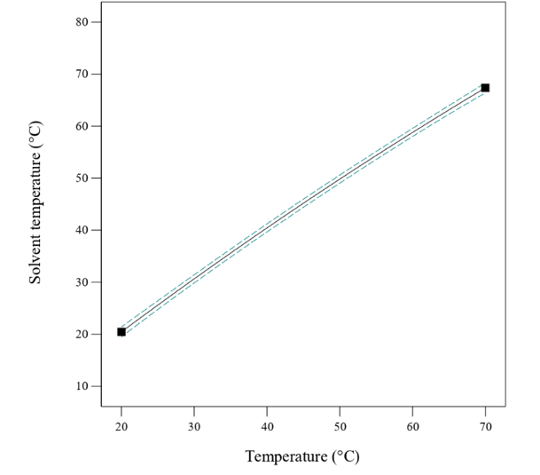
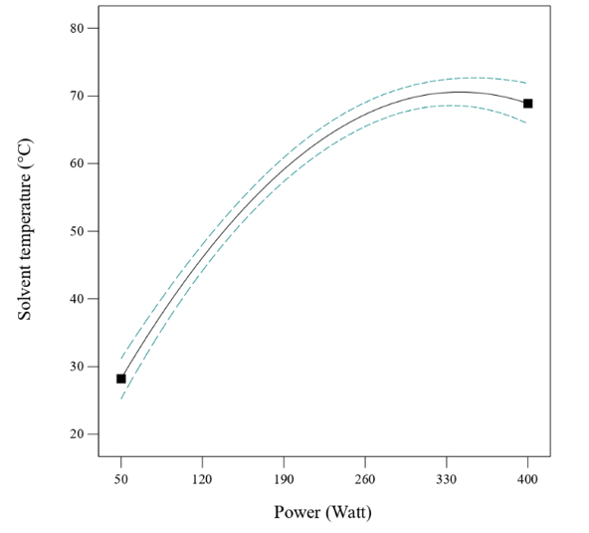
Results and comparison of a 30 minutes extraction
11
8,5
TPC (mg GAE.g⁻¹ DM)
TPC (mg GAE.g^{_1} DM)
Solvent temperature (°C)
Solvent temperature (°C)
Ethanol/water (%)
Temperature (°C)
Ethanol/water (%)
Power (Watt)
Temperature (°C)
Power (Watt)
TPC: total polyphenol content GAE: Gallic acid equivalent

Slide 9
1 hour extraction kinetics
70°C
400 Watt ≈ 70 °C
700 mL volume, 50% ethanol in solvent, 150 rpm, solid to liquid ratio 1 g : 40 mL

Slide 10
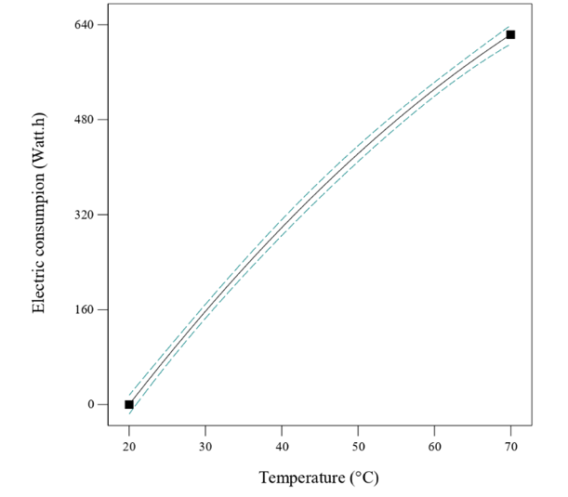
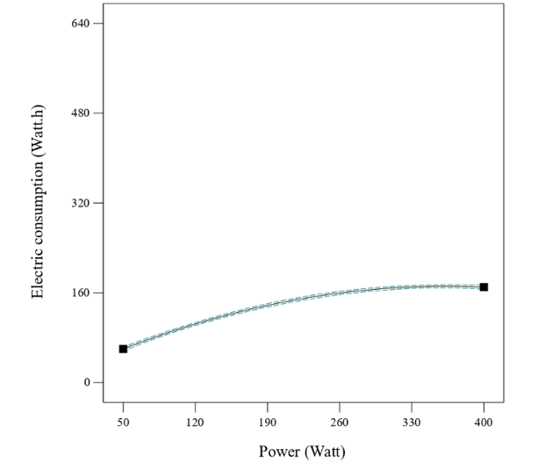
Electrical consumption at 30 minutes
0,01 mg GAE.g⁻¹.Watt⁻¹
0,07 mg GAE.g⁻¹. Watt⁻¹
Electrical consumption (Watt.h⁻¹)
Electrical consumption (Watt.h⁻¹)
Temperature (°C)
Power (Watt)

Slide 11
Cascade valorization applied to spent coffee de grounds
Roasted coffee beans
Coffee
Extraction
Thesis
Global project
Spent coffee grounds
Ressource exhaustion
Eco-extraction
Oil
Solid state fermentation
Pyrolisis
Biochar
Polyphenols
Enzymes
Biogas

Slide 12
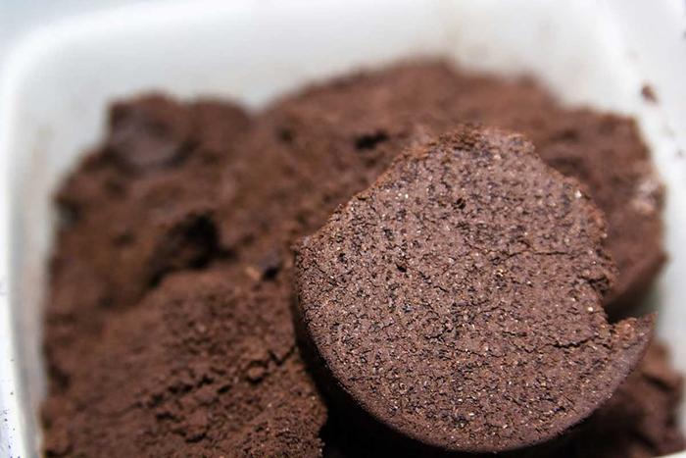
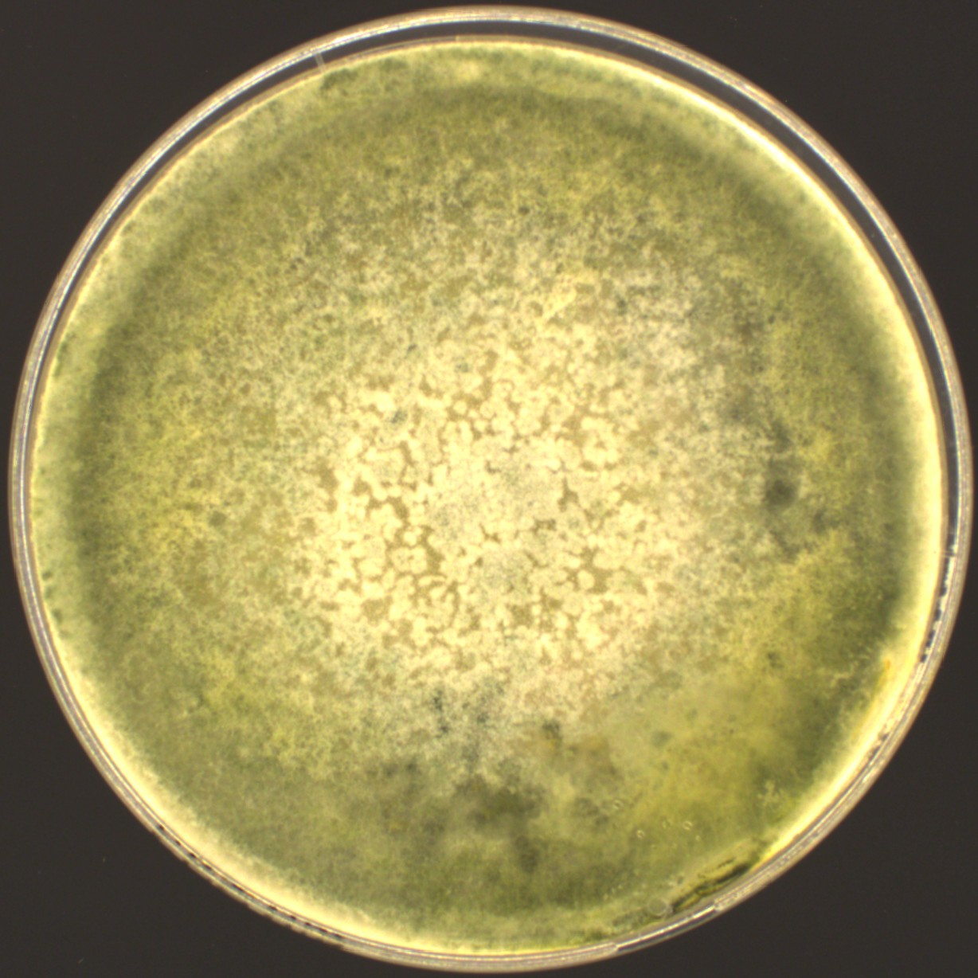
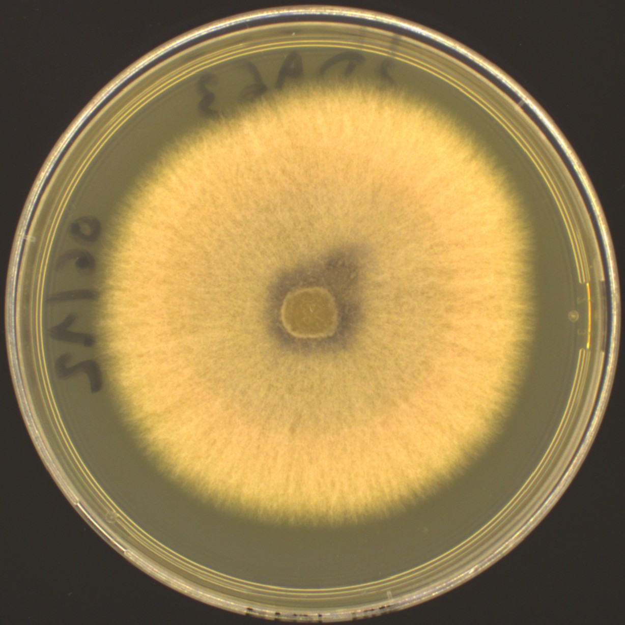
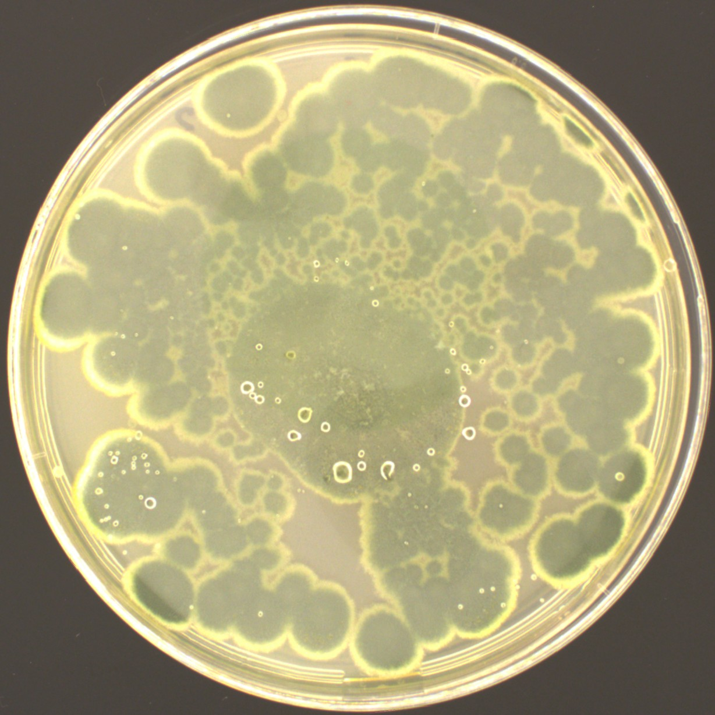
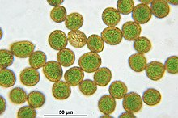
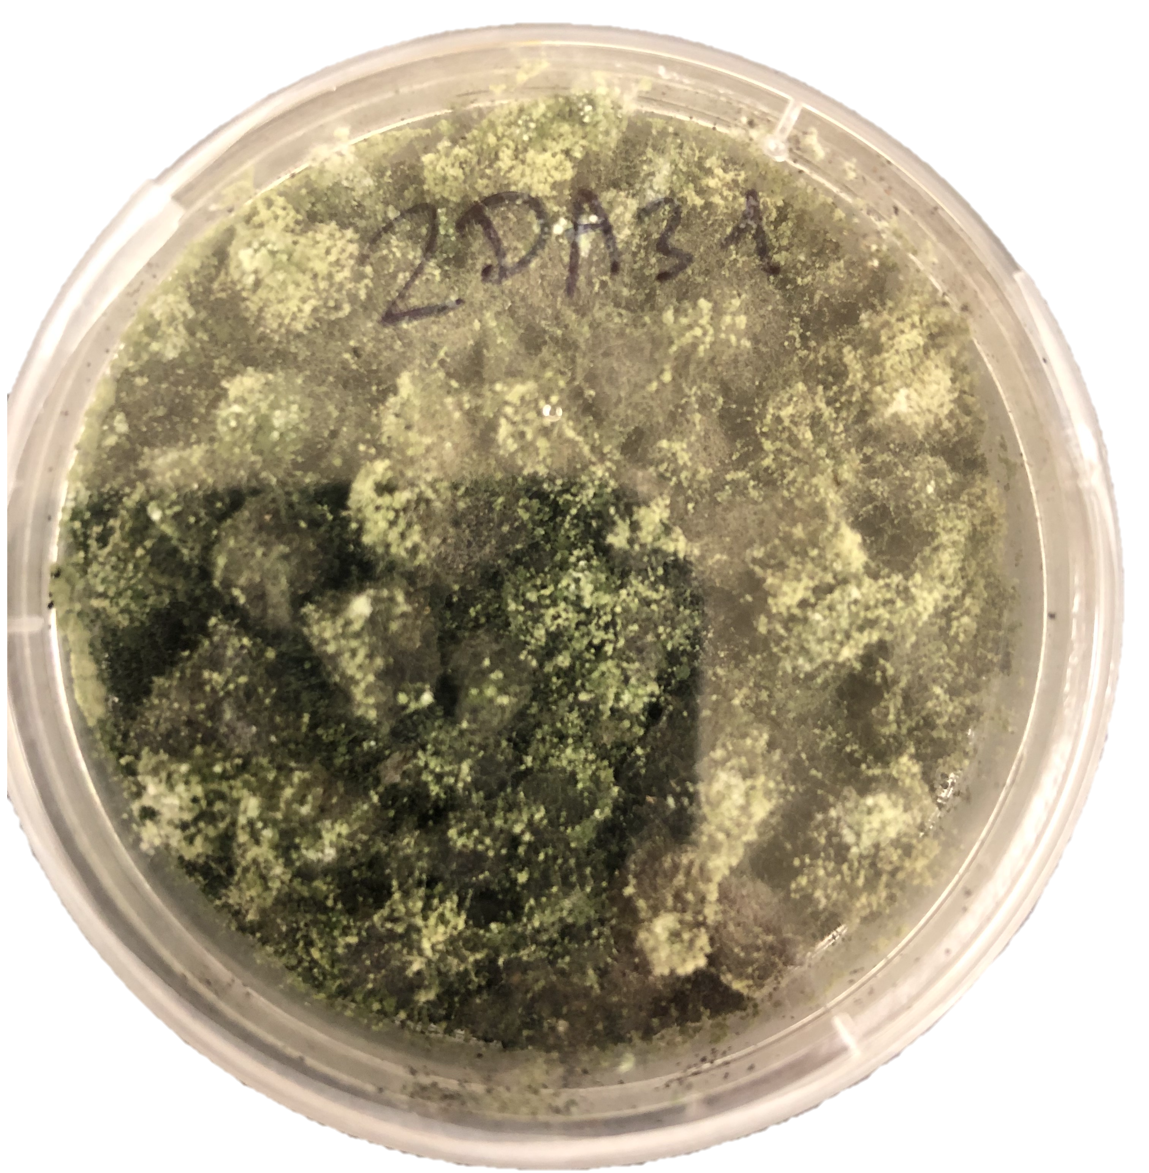
Solid fermentation for enzyme production
Fungi from spent coffee grounds isolation and identification
15 Trichoderma
4 Fusarium
4 Penicillium
3 Aspergillus
And others :
Pleurotus, Acremonium, Paecilomyces, Talaromyces, Exophiala
Solid state fermentation
Lipases
Cellulases
Hemicellulases
Proteases
Biodiesel
Paper industry
Detergent
Cosmetic
Less energy and less water than liquid fermentation
Recycling co-products from the food industry
Notes:
Use the spent coffee grounds remaining after polyphenols extraction for solid state fermentation. At the end, the spent coffe grunds is depleted in sugars

Slide 13
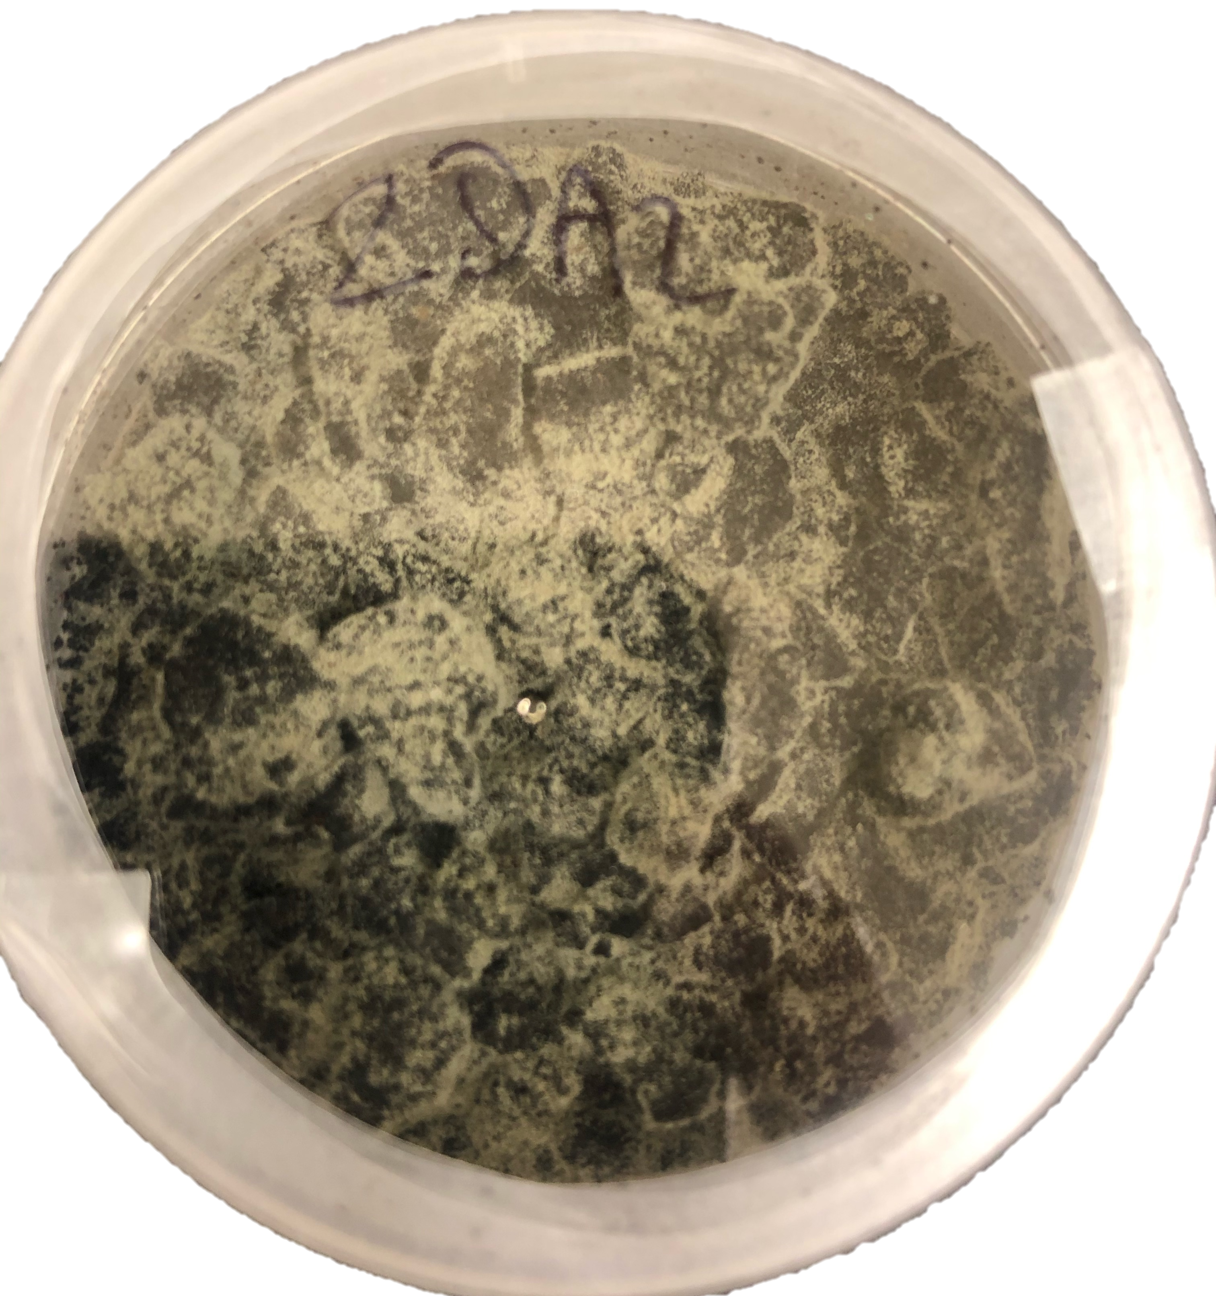
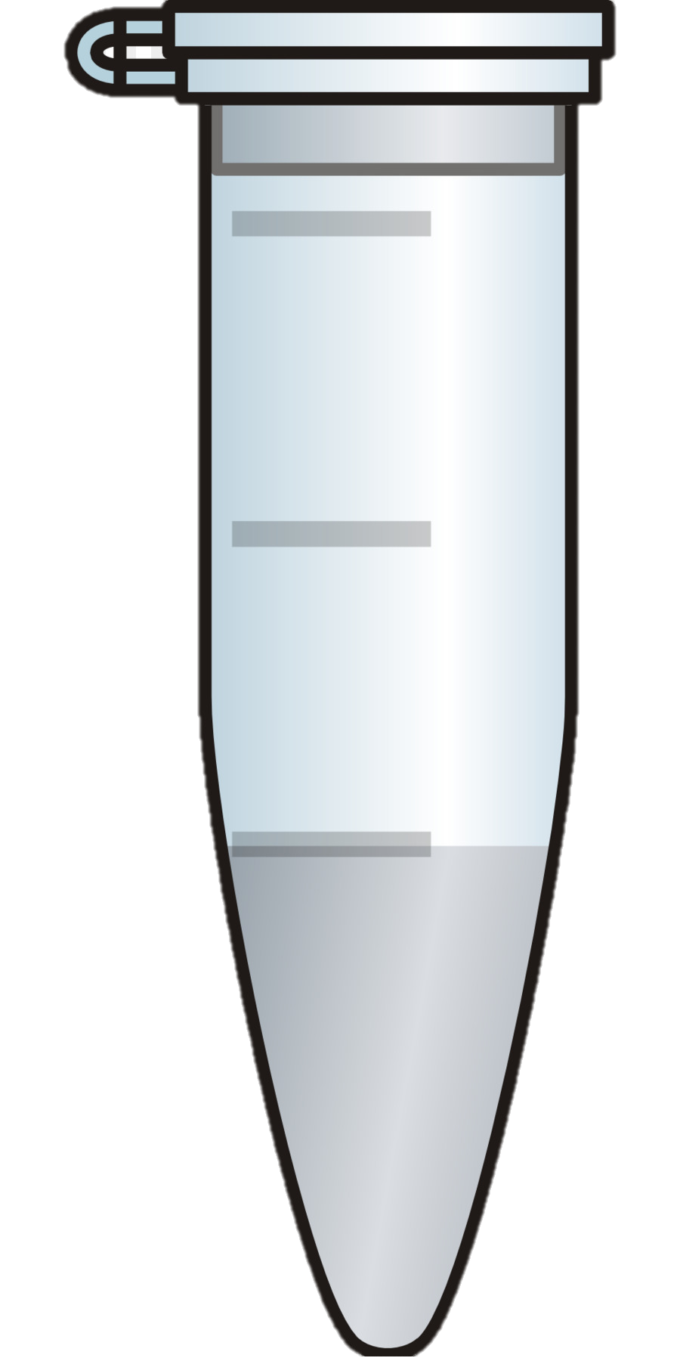
Solid fermentation for enzyme identification
Enzyme cocktail
Electrophoresis SDS Page
FMS
Water extraction
Denaturation
Penicilium
Trichorderma
Precipitation
Digestion
Nano LC-MS/MS
Database comparison
900 peptides => 73 proteins
Proteases
Carboxylases
Others
800 peptides => 50 proteins
Notes:
Use the spent coffee grounds remaining after polyphenols extraction for solid state fermentation. At the end, the spent coffe grunds is depleted in sugars

Slide 14
Solid fermentation for enzyme activity
Enzyme cocktail
FMS
Water extraction
Penicilium
Trichorderma
Fermentation duration
Lipase activity:
P-Nitrophenyl butyrate
Xylanase activity:
Xylan birchwood – DNS
Fermentation duration
Notes:
Use the spent coffee grounds remaining after polyphenols extraction for solid state fermentation. At the end, the spent coffe grunds is depleted in sugars

Slide 15
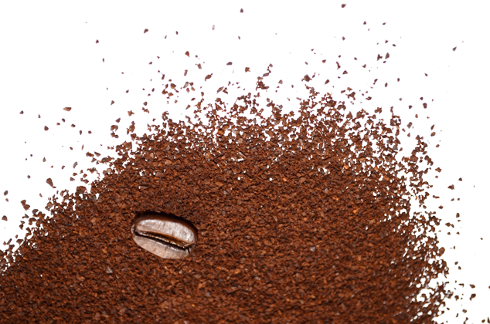
Conclusions
Extract polyphenols with a better efficiency while consuming less energy
Produce, identify and start to characterize enzymes produced from spent coffee grounds depleted in polyphenols
Perspectives
Purify the polyphenols extract
Continue the screening on the other strains
Couple steps of the cascade

Slide 16
Thank YOU for your attention
Maxime Beaudor

Slide 17
Utilisation de la nano LC/MSMS ➔ Exemple Penicillium (2DA2)
Nano LC/MSMS => SN3
LC/MSMS => Realcat
15 fois plus de peptides identifiés

Slide 18
Eco-extraction of antioxidant polyphenols
[1]
[3]
Eco-extraction
Polyphenols
Use of innovative processes
Main polyphenols in spent coffee grounds:
Chlorogenic acids:
5 CQA
3 CQA
3,5 diCQA
Ferulic acid
p-Coumaric acid
Gallic acid
Caffeic acid
Vanillic acid
Reduction of energy impact
Use of clean/green solvents
Reduction of process times
[2]
Ultrasounds
Antioxydant properties
Application in cosmetic, food, pharmaceutical
Cavitation bubbles growth and matrix degradation
[1]: Passos & Coimbra, 2013; Rocha and al., 2014; Michail and al., 2016; Pettinato and al., 2019
[2]: Chemat and al., 2008; Senrayan & Venkatachalam, 2018
[3]: Scalbert et al., 2005; Samarin et al., 2012; Angeloni and al., 2020
Notes:
First of all, what is an eco-extraction, it is the use of innovative related processes that will allow a reduction of the environmental impact of the extraction.
This implies a decrease in electricity consumption compared to conventional processes and the use of green solvents such as ethanol for example. The benefits are numerous and these processes are often more efficient because they also save time.
the use of ultrasound to extract molecules in solid-liquid extraction is part of this innovative process.
Indeed, sonotrodes placed in contact with the solvent containing the vegetal matrix will allow the appearance of small cavitation bubbles which will deform and eventually implode. This implosion will have several effects such as the rise of the solvent emperature due to the released heat, as well as a destructuring mechanical impact on the vegetal matrix
As said before, the molecules we are trying to extract are polyphenols, the coffee grounds contain mainly chlorogenic acids and other acids like Caffeic acid, ferulic acid or vanilic acid. Polyphenols have antioxidant properties and are used in many industries such as cosmetics, food and pharmaceutical

Slide 19
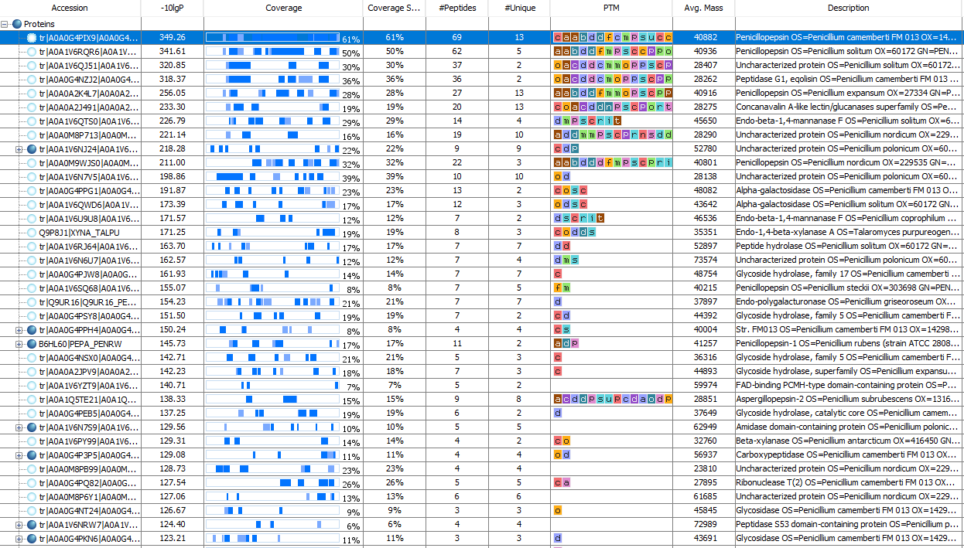

Slide 20
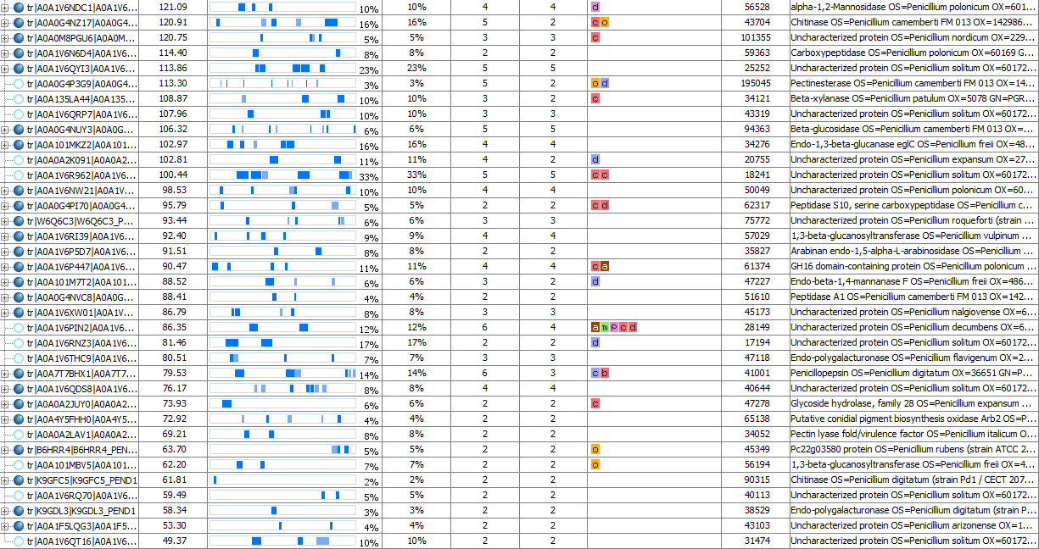

Slide 21
LC/MSMS

Slide 22
Utilisation de la nano LC/MSMS ➔ Exemple Trichoderma (2DA32)
Nano LC/MSMS => SN3
LC/MSMS => Realcat
7,5 fois plus de peptides identifiés

Slide 23
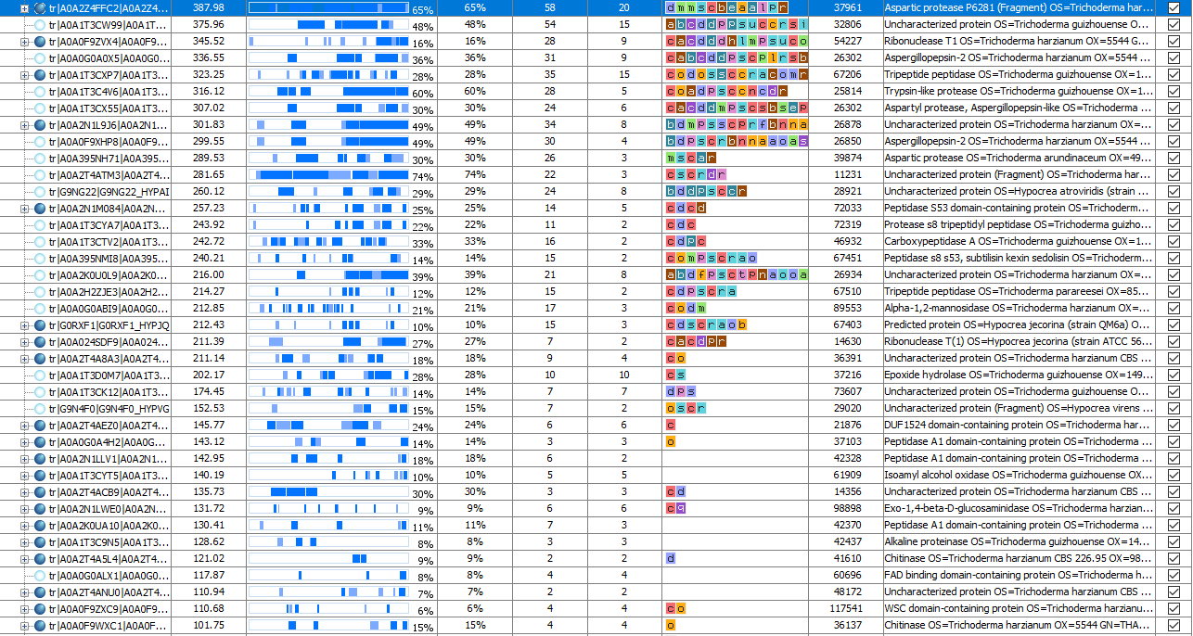

Slide 24
LC/MSMS

Slide 25
En plus
- Protéases identifiées dans tous les échantillons de culture où des peptides ont été relevés.
==> Dosage de l'activité protéase pour les prochaines Manips
- Possible dégradation des autres enzymes (Cellulases, Hémicellulases ou lipases qui sont recherchées) par ces protéases
==> Séparer les extraits enzymatiques en 2 avec une partie pour les dosages d'activité (congélateur) et une partie pour la LC/MSMS (Inactivation 95°C)
- Concentrations des protéines trop faibles :
==> Concentration des échantillons inactivés au speedvac
ou ==> Test Vivaspin 10Kda

Slide 26
Refaire des extraction aux ultrasons pour avoir du substrat
Recommencer en sélectionnant les bons champignons
➔ Récolter les nouveaux spores
Souches x3 |  | Tests à réaliser | Volumes µL | Vol
Penicillium | Congélateur | Protéases | 100 * 3 =300 | 940 µL => 1 mL
Fusarium |  | Cellulases | 60 * 3 = 180
Trichoderma |  | Xylanases Galactodisades | 60 * 3 * 2 = 360
= 9 |  | Lipases | 100
 | Inactivation + speed vac | Gel SDS-Page | 20 | 1,32 mL => 1,5 mL
+1 témoins
 |  | Bradford | 100 * 3 = 300
+ Paracremonium
 |  | Qtof | 1000
+ Paecilomyces | Total |  | => 3 mL | 2,26 mL

Slide 27
Merci à tous

Slide 28
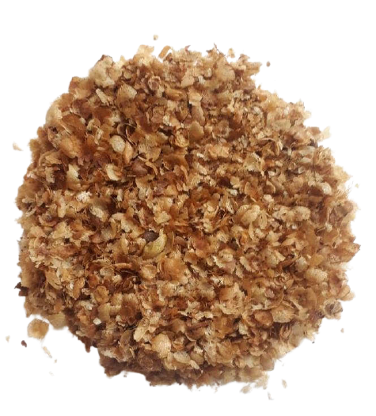
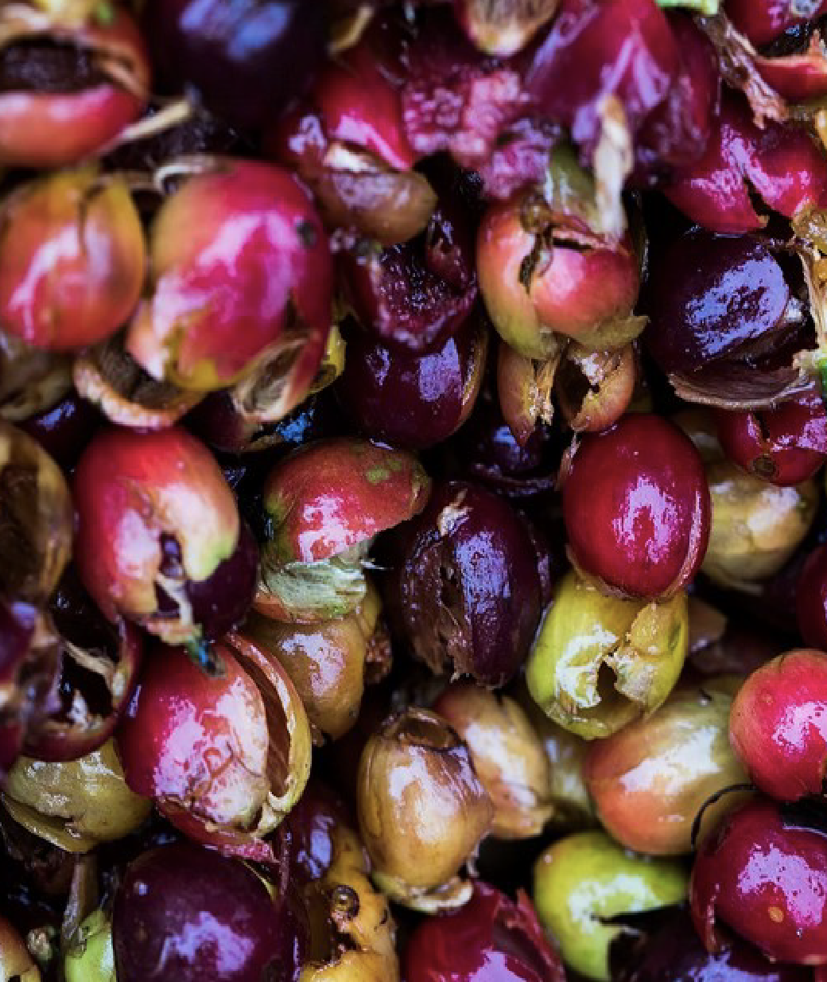
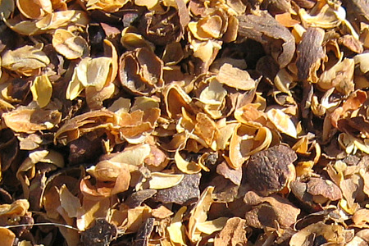
Associated by-product
Coffee manufacturing process
1 kg
Shelling
Roasting
Extraction
Fresh coffee beans
Green coffee beans
Roasted coffee beans
Coffee cup
Coffee pulp
Coffee husk
Coffee silverskin
Spent coffee grounds
650 g
(Ballesteros et al., 2014a; Mussatto et al., 2011a; Nabais et al., 2008)

Slide 29
Cascades valorization
Ressource
Ressource exhaustion
Exhausted ressource
Cascade valorization
Exhausted ressource
Product
Final product
Product
Product
Secondary Cascade valorisation
Exhausted
ressource
Valorized products
(Sirkin, 1994)

Slide 30
The main spent coffee grounds valorizations
Direct applications
Processed products
Extractions
Fertilizer
Compost
Biodiesel
Oil
Incineration
Biogas
Added high-value molecules
(Galanakis C, 2017)

